Slide 1
OBCT: OSS Based Compliance Tooling
Presenter: michael.c.jaeger@siemens.com
Siemens Corporate Technology
© Siemens AG 2018
Notes:
Memo 1

Slide 2
Agenda for Today
A day dedicated to OSS based compliance tooling
  Morning: Updates of tools and introduction of new ones
    Same procedure of last two times
      1. Pitches
      2. Open Round for questions
  Afternoon:
    Updates on the model
    Updates on the Github collaboration space
    Group work:
      More details on the big picture

Slide 3
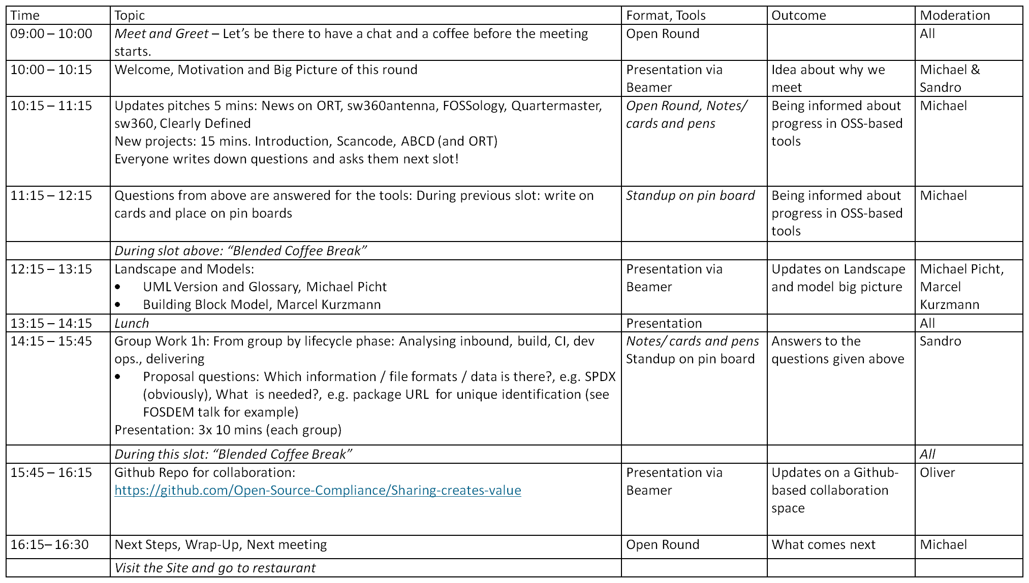
Agenda for Today
A day dedicated to OSS based compliance tooling
  Morning: Updates of tools and introduction of new ones
    Same procedure of last two times
      1. Pitches
      2. Open Round for questions
  Afternoon:
    Updates on the model
    Updates on the Github collaboration space
    Group work:
      More details on the big picture

Slide 4
What happened?
A bunch of people being interested in or working on OSS compliance tools
  Linux Con / “OSS Summit EU” 2017 in Prague on compliance tooling:
  “incredible situation that there are so many OSS tools unlike 5 years ago”
  First meeting: Feb 9th 2018 in Munich at Siemens
    Drawing an initial landscape big picture
  Second meeting: April 12th 2018 in Berlin at Endocode
    Getting a broader picture, corrections on the landscape
  This meeting: July 6th 2018 in Berlin at Bosch
    Getting
  Next Meeting: Océ has volunteered to host in in Munich

Slide 5
What for? – Goal 1
Providing OSS-based compliance tools with a forum
  #1 Understand which OSS-based compliance tools do exist
  and what they do

Slide 6
What for? – Goal 2
Putting the tools into context
  #2 Draw a landscape of tools
  to identify overlap and gaps

Slide 7
What for? – Goal 3
Making gaps obvious means making work obvious
  #3 Encourage contributions to
  OSS-based compliance tooling
  and collaboration between them

Slide 8
What for? – Goal 4
How to concrete work together
  #4 Deploy real case comprised of OSS based compliance tooling interoperating together
  (with information what is required to reach OSS compliance)

Slide 9
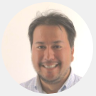
Thank you for your attention … questions?
Siemens AG
Corporate Technology
Otto-Hahn-Ring 6
81379 München
michael.c.jaeger@siemens.com
Michael C. Jaeger
FOSSology links
https://www.fossology.org/
https://github.com/fossology/fossology
SW360 links
https://sw360.github.io/
https://github.com/sw360/sw360portal
Notes:
Notes 9

